Slide 1
Introducing Microsoft Azure

Slide 2
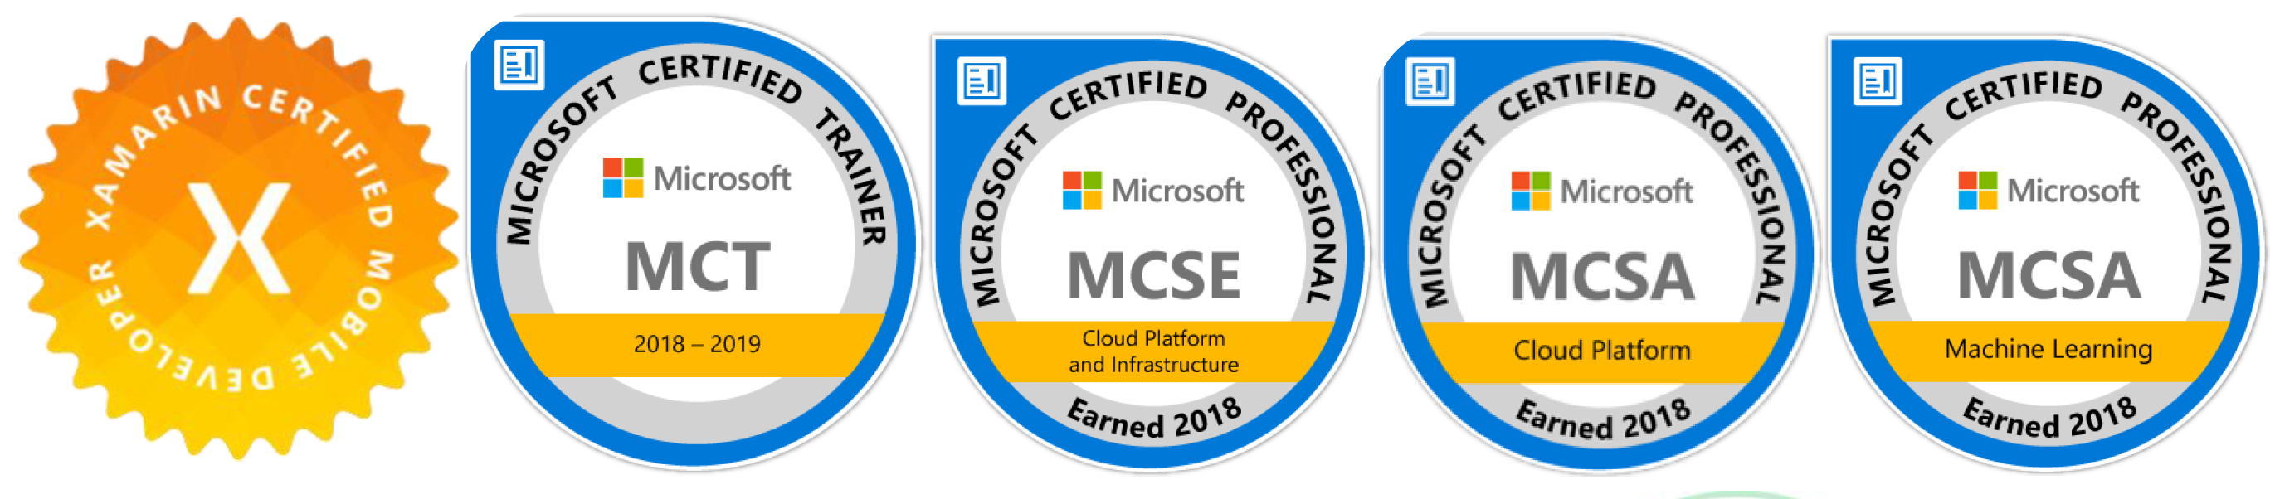
Abhishek Gupta
abhishek.msft@outlook.com
@AbhiForTweeting

Slide 3
Agenda.
Schedule | Item | Duration
9:00 AM to 9:30 AM | Introduction to Cloud development strategies | 30 mins
9:30 AM to 10:00 AM | Azure Pass registrations | 30 mins
10:00 AM to 11:00 AM | Introduction to Cloud services (IaaS, PaaS, SaaS) | 1 hour
11:00 AM to 11:15 AM | Break | 15 mins
11:15 AM to 12:00 PM | Introduction to ASP.NET Core WebAPI | 45 mins
12:00 PM to 01:00 PM | Hands on - ASP.Net Core WebApi | 1 hour
01:00 PM to 02:00 PM | Lunch | 1 hour
02:00 PM to 02:45 PM | Going serverless with Azure Functions | 45 mins
02:45 PM to 03:45 PM | Hands on - Azure Function App | 1 hour
03:45 PM to 04:00 PM | Break | 15 mins
04:00 PM to 04:45 PM | Introduction to Containers | 45 mins
04:45 PM to 05:30 PM | Hands On - Managing an ASP.Net Core WebAPI via Container instances | 45mins

Slide 4
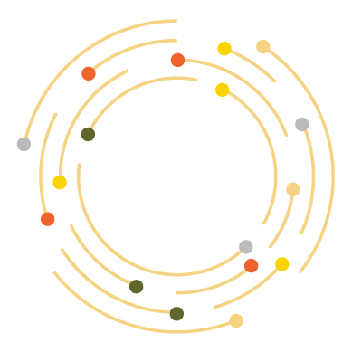

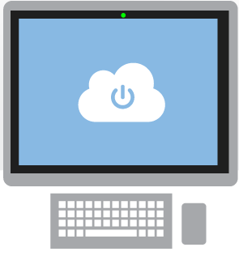
What is the cloud?
An approach to computing that’s about internet scale and connecting to a variety of devices and endpoints
Notes:
Speaking Points:
There are numerous terms and definitions floating around in the industry for “the cloud”, “cloud computing”, “cloud services”, etc.
Microsoft thinks of the cloud as simply an approach to computing that enables applications to be delivered at scale for a variety of workloads and client devices.
The cloud can help deliver IT as a standardized service…freeing you up to focus on your business

Slide 5



Cloud Computing
IaaS
PaaS
SaaS
Infrastructure-as-a-Service
Platform-as-a-Service
Software-as-a-Service
host
build
consume
Notes:
Slide Objectives:
Explain the three established industry terms for cloud services
Speaker Notes:
There is a lot of talk in the industry about different terms like Platform as a Service, Infrastructure as a Service, and Software as a Service.
Since PDC08 when we first announced the Windows Azure our focus has been on delivering a platform as a service offering where you can build applications. Where the platform abstracts you from the complexities of building and running applications.
We fundamentally believe that the future path forward for development is by providing a platform. In fact, as you’ll see in a few minutes, we believe that there are a number of new capabilities that should be delivered as services to the platform.
Notes:
There is a lot of confusion in the industry when it comes to the cloud.
It’s important that you understand both what is happening in the industry and how we think about the cloud.
This is the most commonly used taxonomy for differentiating between types of cloud services.
The industry has defined three categories of services:
IaaS – a set of infrastructure level capabilities such as an operating system, network connectivity, etc. that are delivered as pay for use services and can be used to host applications.
PaaS – higher level sets of functionality that are delivered as consumable services for developers who are building applications. PaaS is about abstracting developers from the underlying infrastructure to enable applications to quickly be composed.
SaaS – applications that are delivered using a service delivery model where organizations can simply consume and use the application. Typically an organization would pay for the use of the application or the application could be monetized through ad revenue.
It is important to note that these 3 types of services may exist independently of one another or combined with one another.

Slide 6
Cloud Services (a.k.a Cloud Models)
On Premises
Infrastructure
(as a Service)
Platform
(as a Service)
Software
(as a Service)
You manage
Applications
Applications
Applications
Applications
Data
You manage
Data
Data
Data
Runtime
Runtime
Runtime
Runtime
Managed by Microsoft
You manage
Middleware
Middleware
Middleware
Middleware
Managed by Microsoft
O/S
O/S
O/S
O/S
Managed by Microsoft
Virtualization
Virtualization
Virtualization
Virtualization
Servers
Servers
Servers
Servers
Storage
Storage
Storage
Storage
Networking
Networking
Networking
Networking
Notes:
Slide Objectives:
Explain the differences and relationship between IaaS, PaaS, and SaaS in more detail.
Speaking Points:
Here’s another way to look at the cloud services taxonomy and how this taxonomy maps to the components in an IT infrastructure.
Packaged Software
With packaged software a customer would be responsible for managing the entire stack – ranging from the network connectivity to the applications.
IaaS
With Infrastructure as a Service, the lower levels of the stack are managed by a vendor. Some of these components can be provided by traditional hosters – in fact most of them have moved to having a virtualized offering.
Very few actually provide an OS
The customer is still responsible for managing the OS through the Applications.
For the developer, an obvious benefit with IaaS is that it frees the developer from many concerns when provisioning physical or virtual machines.
This was one of the earliest and primary use cases for Amazon Web Services Elastic Cloud Compute (EC2).
Developers were able to readily provision virtual machines (AMIs) on EC2, develop and test solutions and, often, run the results ‘in production’.
The only requirement was a credit card to pay for the services.
PaaS
With Platform as a Service, everything from the network connectivity through the runtime is provided and managed by the platform vendor.
The Windows Azure best fits in this category today.
In fact because we don’t provide access to the underlying virtualization or operating system today, we’re often referred to as not providing IaaS.
PaaS offerings further reduce the developer burden by additionally supporting the platform runtime and related application services.
With PaaS, the developer can, almost immediately, begin creating the business logic for an application.
Potentially, the increases in productivity are considerable and, because the hardware and operational aspects of the cloud platform are also managed by the cloud platform provider, applications can quickly be taken from an idea to reality very quickly.
SaaS
Finally, with SaaS, a vendor provides the application and abstracts you from all of the underlying components.

Slide 7
Cloud Services being hungry!
On Premises
Made at home
IaaS
Take and Bake
PaaS
Pizza delivered
SaaS
Dine out
You manage
Dining Table
Dining Table
Dinning Table
Dinning Table
Soda
You manage
Soda
Soda
Soda
Electricity/Gas
Electricity/Gas
Electricity/Gas
Electricity/Gas
Managed by Vendor
You manage
Oven
Oven
Oven
Oven
Managed by Vendor
Fire
Fire
Fire
Fire
Pizza Dough
Pizza Dough
Managed by Vendor
Pizza Dough
Pizza Dough
Tomato Sauce
Tomato Sauce
Tomato Sauce
Tomato Sauce
Toppings
Topping
Topping
Topping
Cheese
Cheese
Cheese
Cheese

Slide 8
Why the cloud?

Slide 9
Why the cloud?
Rapidly setup environments to drive business priorities
Scale to meet peak demands
Increase daily activities, efficiency and reduced cost.
Speed
Scale
Economics

Slide 10
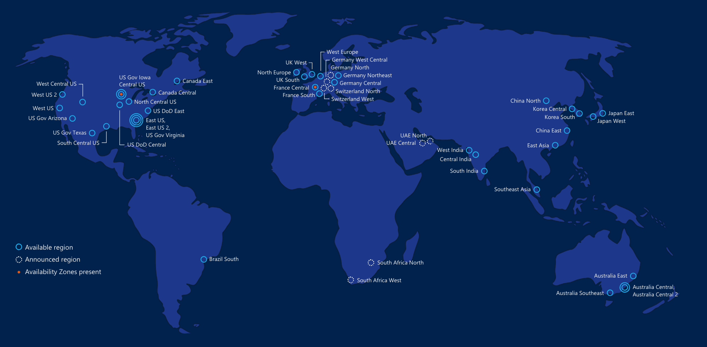
50
Azure compute regions open today
More than AWS and Google Cloud combined
Datacenters recently added in Canada, China, and India
Infrastructure
designed for Scale
Notes:
And you get all the goodness shown in the previous slides across the WW

Slide 11
Hyper-scale
Azure
Enterprise proven
Hybrid

Slide 12
Leading the journey to the Cloud
Microsoft Azure
Developer + App Platform
Visual Studio Family + Azure App Service
Data + Analytics
Cortana Analytics Suite
Internet of Things
Azure IoT Suite
Cloud Infrastructure
Azure + Azure Stack + Operations Management Suite

Slide 13









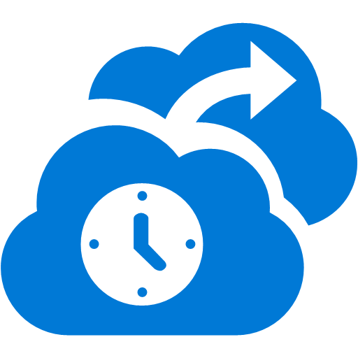










Microsoft Azure
Cloud Infrastructure
Compute
Security + Management
Networking
Hybrid Operations
Developer + App Platform
Visual Studio Family + Azure App Service
Virtual Machines
Active Directory
Express Route
Azure AD Connect Health
Containers
Multi-Factor Auth
Virtual Network
AD Privileged Identity Mgmt
Data + Analytics
Cortana Analytics Suite
Remote App
Automation
Load Balancer
Backup
Batch
Key Vault
DNS
Operational Insights
Internet of Things
Azure IoT Suite
Storage
Traffic Manager
Import/Export
Blob Storage
Azure Files
Premium Storage
VPN Gateway
StorSimple
Cloud Infrastructure
Azure + Azure Stack + Operations Management Suite
Application Gateway
Site Recovery

Slide 14
Demo: Azure Portal

Slide 15













Microsoft Azure
Developer + App Platform
App Platform Services
Integration
Development Tools
Media & CDN
SAAS Solutions
Microsoft Dynamics
Content Delivery Network
App Service
Storage Queues
Visual Studio
Microsoft Azure
Notification Hubs
BizTalk Services
Visual Studio Online
Media Services
Enterprise Mobility
Microsoft Enterprise Mobility Suite
Developer + App Platform
Visual Studio Family + Azure App Service
API Management
Hybrid Connections
Application Insights
Cortana Analytics Suite
Data + Analytics
Service Fabric
Service Bus
Azure SDK
Cloud Services
Internet of Things
Azure IoT Suite
Cloud Infrastructure
Azure + Azure Stack + Operations Management Suite

Slide 16


Azure App Service Build and scale great cloud apps
Web Apps
Mobile Apps
Logic Apps
API Apps
.NET, Java, Node.js, PHP, Python
Auto patching
Auto scale
Integration with existing apps
Continuous deployment
Notes:
App Service has everything you need to build apps that target both web and mobile clients from a single app back-end.
Using API Apps, you can connect your app to dozens of popular services like Office 365 and salesforce.com in minutes, and integrate your own APIs so they can be used within any app.
And finally with Logic Apps, you can automate business processes using a simple no-code experience.

Slide 17
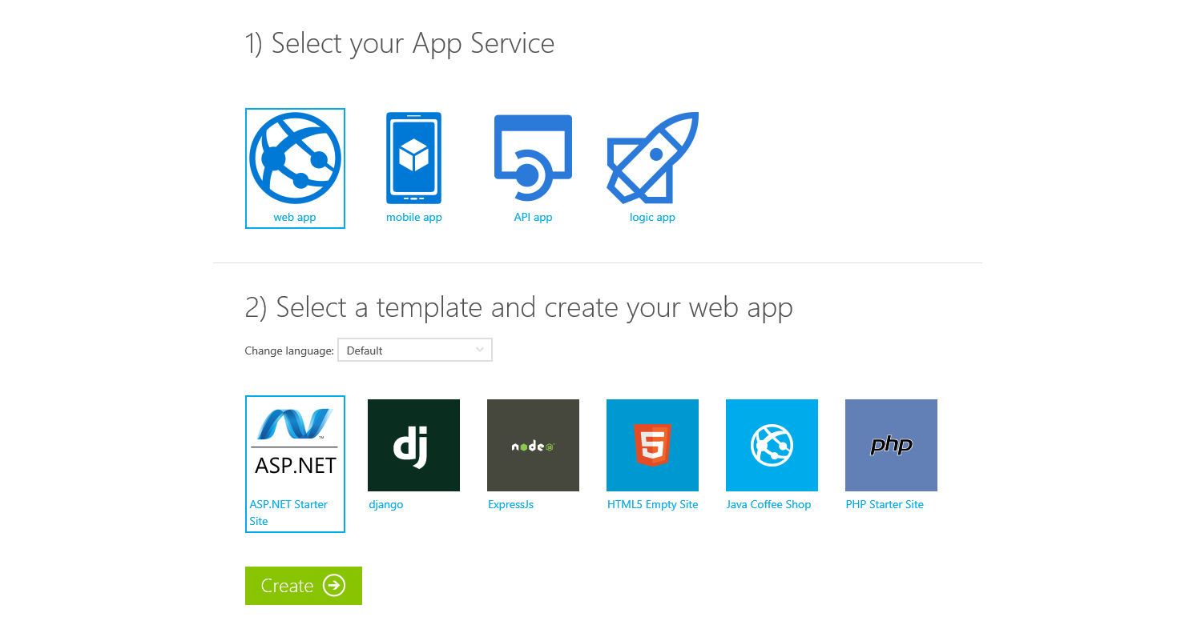
Try App Service Today
https://tryappservice.azure.com
No Cost
No Signup or Account Required

Slide 18



Azure App Service Web Apps
Start simple
Code smart
Go live
Easily create and scale your new sites in seconds
Automatically scale your sites that scale with your business
Quickly improve performance and reduce latency with right resources
Built-in web jobs support
Leverage existing skills – Languages and databases you know
Start with open source apps and frameworks
Develop with VS and WebMatrix
Supports X-Plat development
Improve developer productivity through continuous automated deployment
Built-in monitoring of perf and usage data
Built-in diagnostics to assist with debugging
Built for DevOps
Office Blog ASP.NET site microsoft.com
Notes:
Speaker notes:
Start simple
Emphasize rapid deployment of Web Apps from choice of Asp.Net starter applications to thousands of pre-built certified, opensource, and community software applications, add-ons, and data analysis platforms pre-configured for Azure.
Explain how Web Apps use automatic load balancing to scale out.
With Web Apps its easy to scale out automatically with increasing instance count using autoscale features e.g. CPU Load, scheduled
Easily improve performance of Web Apps and reduce latency of by changing to right instance size with zero downtime
Supports cron jobs
Code smart
Leverage existing skills to start coding for Web Apps without expensive retraining:
Languages: .NET, Java, NodeJS, PHP, Python. Databases: SQL Server, MySql .
Start coding with any development tools on any platforms such as Linux, OSX and Windows.
Go live
Built for DevOps – Agility through continuous deployment.
Encourages iterative development and improves developer productivity through continuous automated deployment enabled by Web Apps’ integrated source control connectivity to Team Foundation Server(TFS) and Git.
Easily monitor key performance metrics in a verbose or minimal fashion. Easily access monitoring data from a storage account externally for further analysis.
Easily enable diagnostics logging and add instrumentation. Easy access to information logged.

Slide 19
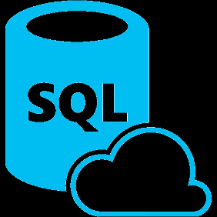


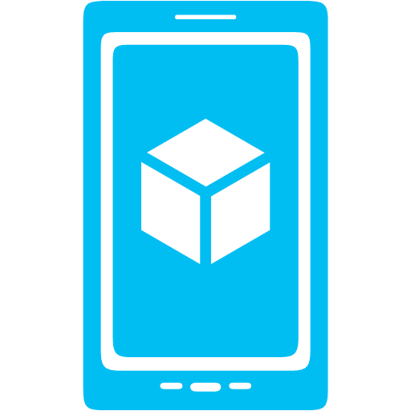



Azure App Service Mobile Apps
Provides essential services to support client development
Client Support
iOS
Android
HTML5/Web
Xamarin
Windows
Windows Phone
PhoneGap
Sencha
Storage
Authentication
Logic
Push
Scheduler
Notes:
Speaking Notes
Azure Mobile Services is a Backend-as-a-Service
Instead of you having to design, build, test, deploy, manage, and upgrade your whole backend, we do it for you
Features of Mobile Services
Storage – SQL DB
Authentication – built in support for social providers w/ ability to custom auth
Backend logic – data validation, logical flows, etc
Push Notifications – across all major mobile platforms
Scheduler – backend job processing

Slide 20










Microsoft Azure
SAAS Solutions
Microsoft Dynamics
Data + Analytics
Data
Analytics
Enterprise Mobility
Microsoft Enterprise Mobility Suite
SQL Database
SQL Data Warehouse
HDInsight
Data Factory
DocumentDB
Data Lake
Machine Learning
Mobile Engagement
Developer + App Platform
Visual Studio Family + Azure App Service
Redis Cache
Tables
Search
Data + Analytics
Cortana Analytics Suite
Internet of Things
Azure IoT Suite
Cloud Infrastructure
Azure + Azure Stack + Operations Management Suite

Slide 21
Intelligent action
What happened?
Why did it happen?
What will happen?
What should I do?

Slide 22
Power BI
Machine Learning
SQL Data Warehouse
HDInsight
Data Lake Analytics
Data Lake Store
Stream Analytics
Data Factory
Data Catalog
Event Hubs
Information management
Big Data stores
Machine Learning
Analytics

Slide 23

Microsoft Azure
SAAS Solutions
Microsoft Dynamics
Enterprise Mobility
Microsoft Enterprise Mobility Suite
Developer + App Platform
Visual Studio Family + Azure App Service
Internet of Things
IoT Hub
Stream Analytics
Logic Apps
Data + Analytics
Cortana Analytics Suite
Internet of Things
Azure IoT Suite
Cloud Infrastructure
Azure + Azure Stack + Operations Management Suite

Slide 24
Things
Now Available to Purchase Azure IoT Suite
Device Connectivity and Security
Data Ingestion and Command & Control
Stream Processing & Predictive Analytics
Workflow Automation
Dashboards and Visualization
Preconfigured Solutions
Notes:
Talking Points:
With Azure IoT Suite we give you a very comprehensive solution that’s designed to help you connect your devices, whether a few hundred or millions across the world, analyze all the data coming from these devices and take action from the insights by integrating with your back end systems. IoT Suite bring together and offer the following capabilities:
Device connectivity and security: Connect to millions of devices simultaneously. Enhance security of your IoT solutions by taking advantage of per-device authentication to communicate with devices that have the appropriate credentials. Revoke access rights to specific devices to maintain the integrity of your system.
Data Ingestion & Command & Control: Establish reliable, bi-directional communication with these assets, even if they are intermittently connected, and analyze—and act on—incoming telemetry data.
Workflow automation: Integrates with your company’s existing back-end systems to enable you to make the best use of the data and processes you already have. Whether it’s as simple as sending a text or integrating with your CRM or EPP system
Dashboards & Visualization: Create powerful and rich visualization experience and finally
Preconfigured solutions: One of the biggest value we can provide is helping you develop IoT solutions faster. This will not only allow you to do more PoCs and pilots, it will also help accelerate the long project cycles we spoke about earlier. We do this by offering preconfigured solutions for the more common IoT scenarios.

Slide 25
Get started today at http://azure.microsoft.com

